Slide 1
Hypothesis Generation

Slide 2
In-Class Assignment
You have been hired by the Federal Railroad Administration to explore factors that contribute to accident severity. Severity is measured by 2 metrics- cost and human life and injury.
Utilize the multivariate visualization methods learned in class to develop at least 2 hypotheses between categorical variables and ACCDMG about what actions the FRA could take to reduce the severity of rail accidents.
Explain why the hypotheses are actionable (i.e., how they could lead to meaningful recommendations) and explain how you arrived at each hypothesis. Write out your null and alternative hypotheses.

Slide 3
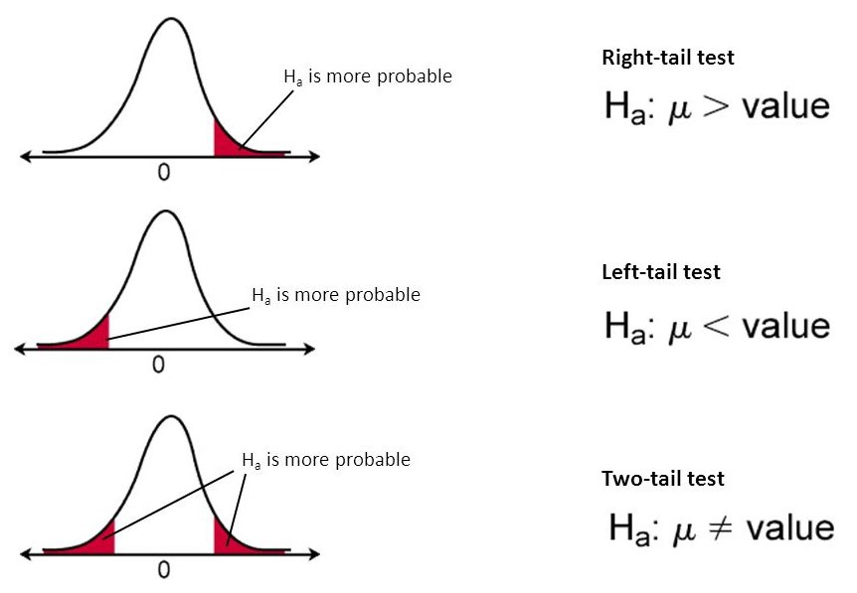
Elements of a Hypothesis
Null Hypothesis, H0
Alternative Hypothesis, Ha
We assume H₀ is true and then see if there is enough evidence in the data to indicate that it is not true. In that case, we reject H₀ in favor of the alternative, H_{a}.
So if we think TRNSPD increases ACCDMG, what would be our null and alternative hypotheses? Is this an actionable hypothesis to test?

Slide 4
Example 1
Can you generate any hypotheses from the SPM? Are they actionable and practical?
RQs
Weather?
Speed?
Hypotheses?

Slide 5
Example 2
Can you generate any hypotheses from the plots? Are they actionable and practical?
RQs
Do faster train speeds cause more severe accidents and does the relationship vary by cause?
Does weather contribute to more severe accidents?
Does derailment lead to more severe accidents?
Hypotheses?

Slide 6
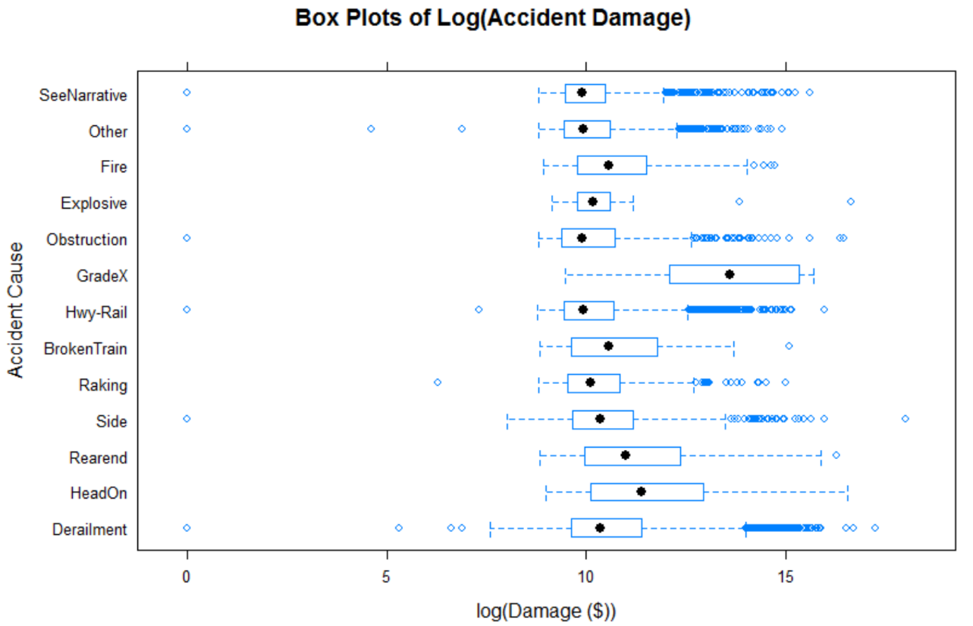
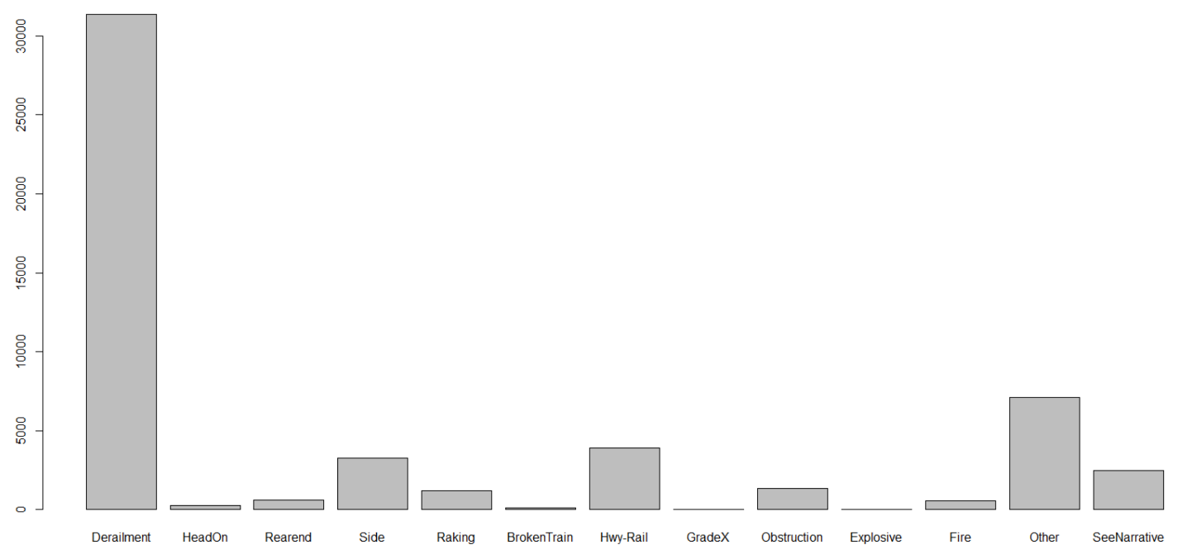
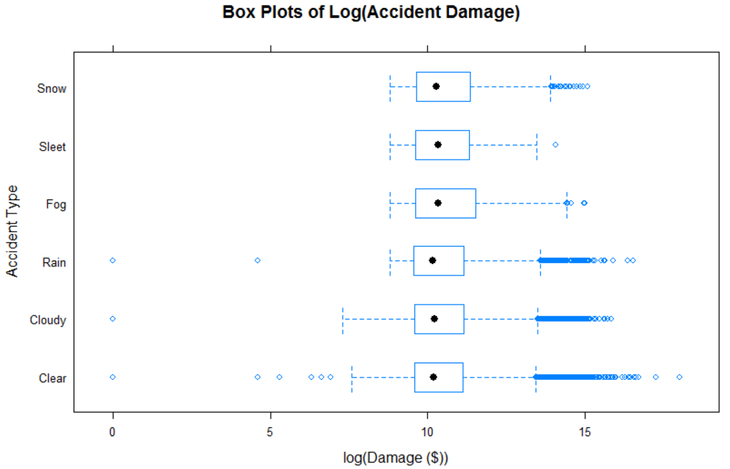
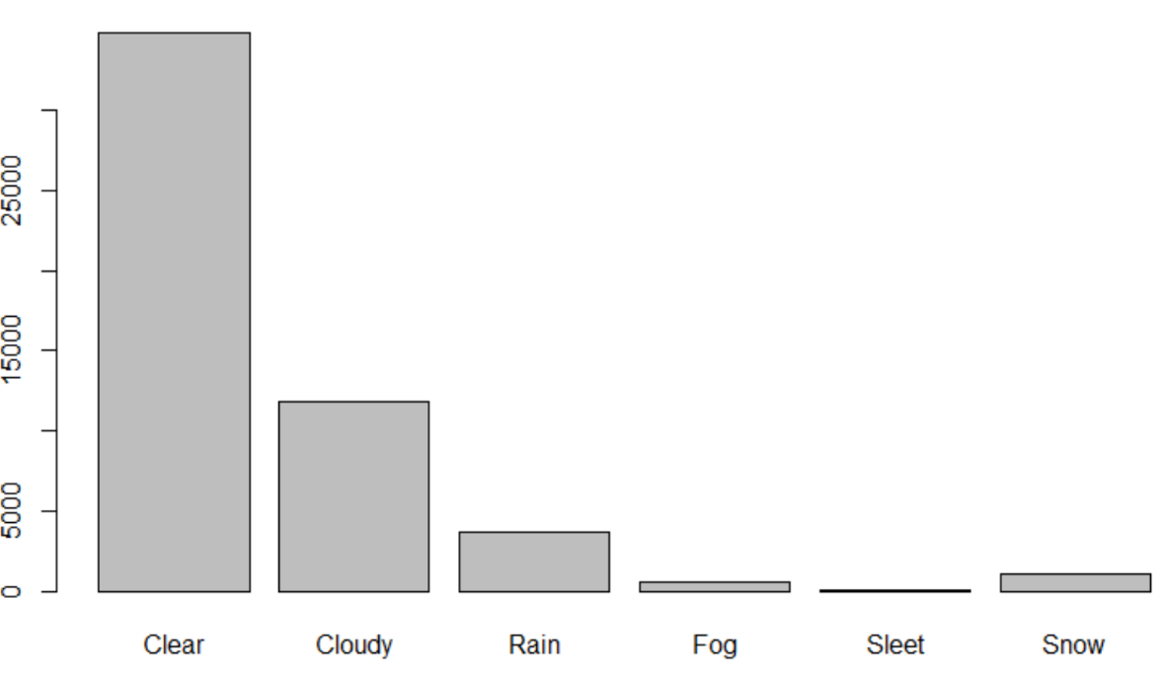
Example 3
Can you generate any hypotheses from the plots? Are they actionable and practical?
RQs
Are accidents of a particular type more likely to be severe (derailment, explosive, fire)? Under what conditions were the average/peak train speeds?
Are accidents during rain, fog, sleet, or snow more severe than accidents during clear or cloudy weather?
Hypotheses?

